Slide 1
How to listen to Audiobooks on
By Mike Angstadt
MC-NPL Computer Lab
www.mc-npl.org
Revised: 8/10/2015

Slide 2
What is OneClickdigital?
OneClickdigital is a service that provides digital audio recordings of classical books. All library card holders have access to this service.

Slide 3
What you will need
Your library card barcode number
An email address

Slide 4
Registering with the Website
Before you can start using the OneClickdigital service, you must create an account.

Slide 5
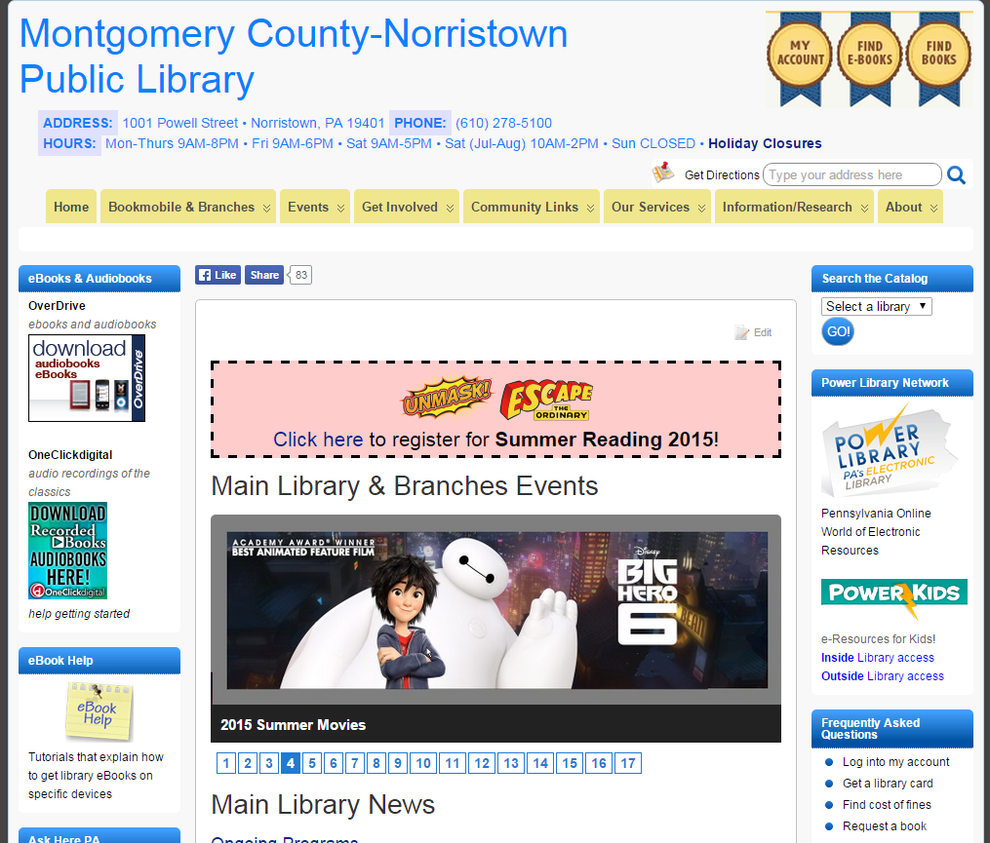
Go to the library’s website: www.mc-npl.org.
Click on the logo for OneClickdigital on the left side of the screen. This will take you to the OneClickdigital website.

Slide 6
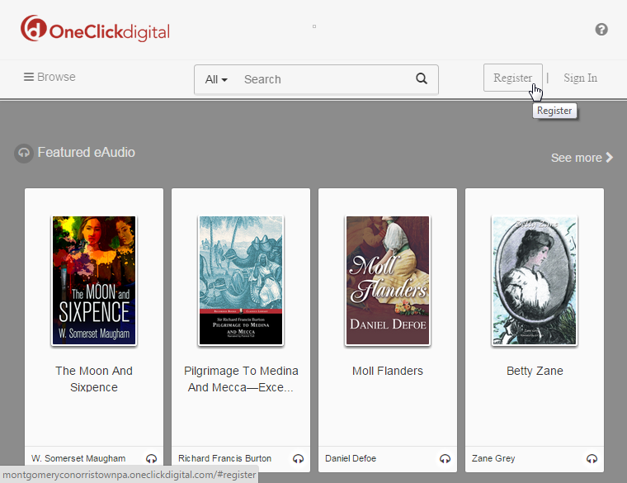
Click on “Register” at the top-right of the screen.

Slide 7
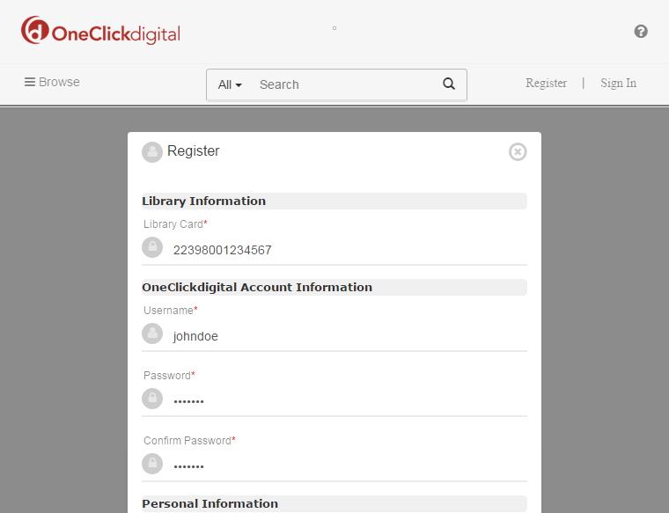
Fill out the registration form. Click the “Register” button at the bottom of the form when you are done.
Don’t forget your username and password! You will need this information to log back into the website the next time you visit it, or to log onto the service from your mobile device.

Slide 8
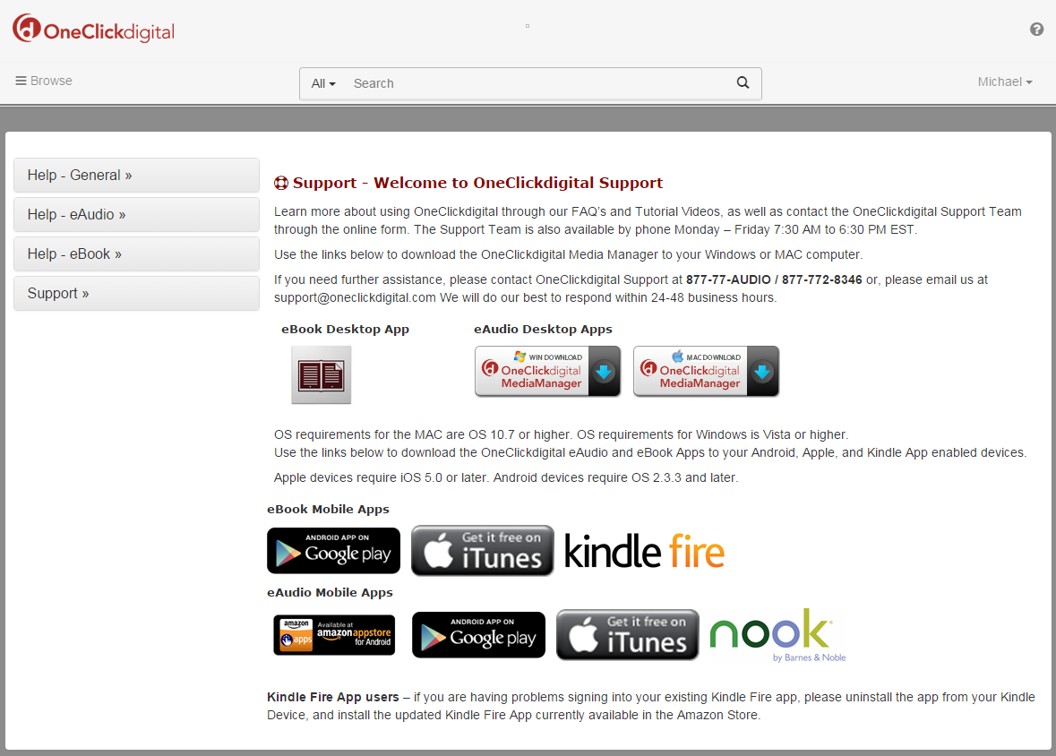
Note your name in the upper-right corner. You are now registered and signed-into the website.

Slide 9
Checking out an Audiobook
Before you can start listening to an audiobook, you have to check one out first. To find a book to checkout, you can either browse or search for a book.

Slide 10
Browsing
To browse books, click the “Browse“ icon in the upper-left corner of the screen. From this menu, you can do things like look at the most popular books or browse by genre.

Slide 11
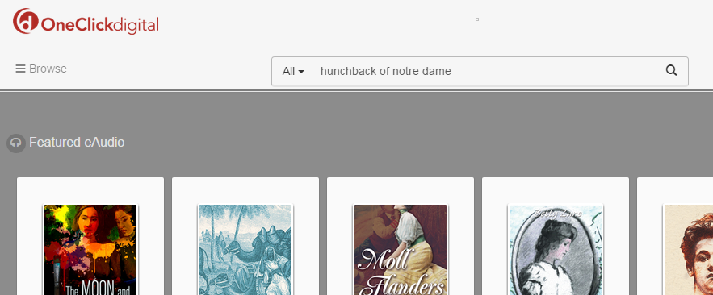
Searching
If you have a specific book in mind, you can search for the book instead of browsing for it. To search for books, click in the search textbox located in the top-center of the screen, and type your search term (for example, the book’s title or author).

Slide 12
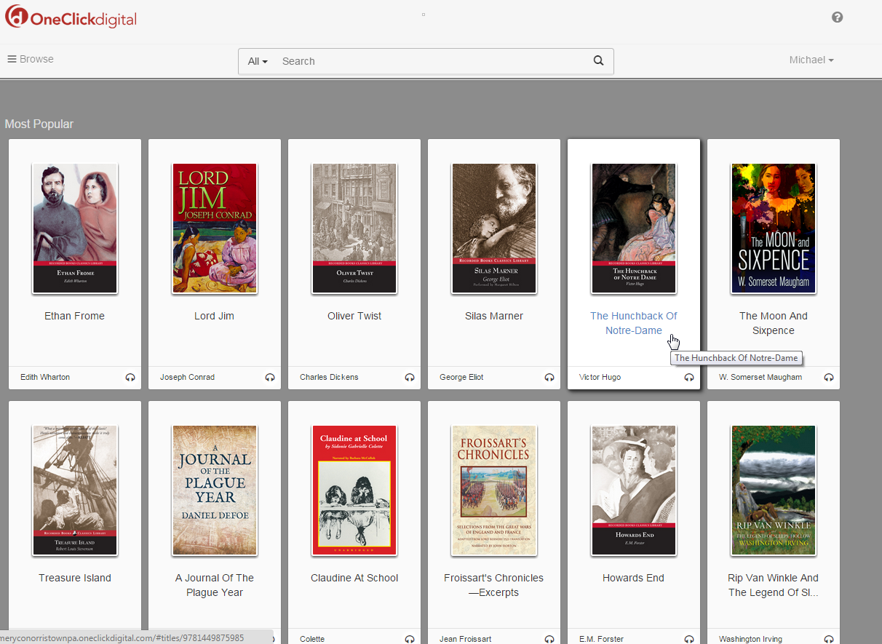
Checking Out
Next, click on the book you want to check out.

Slide 13
Checking Out
Click the yellow “Checkout Now” button to check out the audiobook.
The audiobook will be checked-out for 10 days, by default.

Slide 14
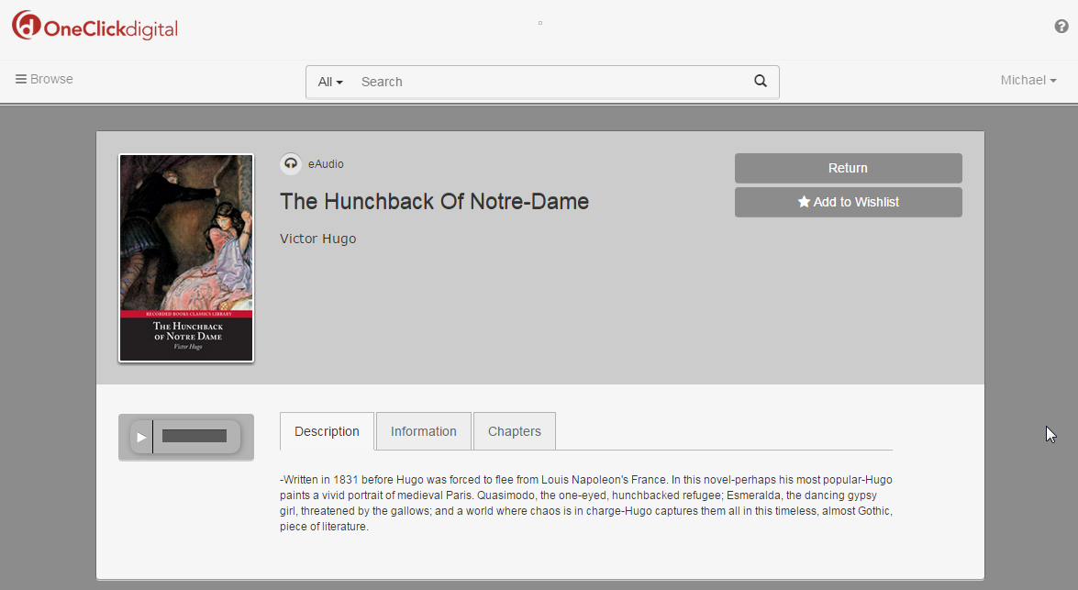
Checking Out
Notice how the “Checkout Now” button was replaced with a “Return” button. This means the book is checked-out to your account.
Note: Your web browser may download a file when you check out the book. You can ignore this file. This file is used by the OneClickdigital Media Manager, which is not covered by this tutorial.

Slide 15
Listening to a Book
Now that you’ve checked out a book, you can finally start listening to it.

Slide 16
First, we need to view your checked-out items. Click on your name in the upper-right corner of the screen and then click “My Titles”.

Slide 17
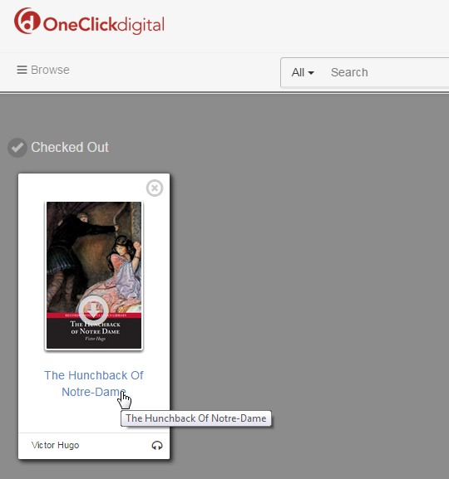
This screen shows all of the audiobooks you have checked out. Click on the book’s title to open it. Do not click on the book’s picture, as this will download file used by the OneClickdigital Media Manager (not covered by this tutorial).

Slide 18
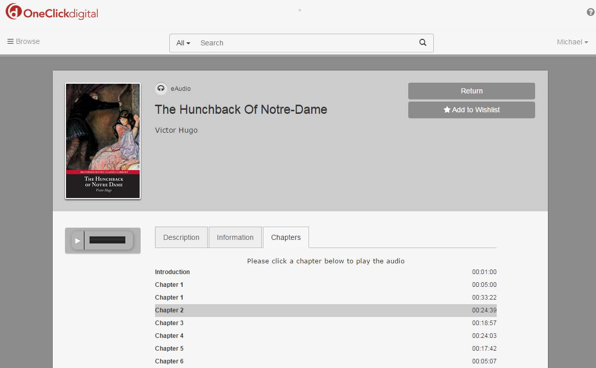
Click on the “Chapters” tab (1). Then, click on the chapter you want to listen to (2) and click the “Play” button (3).
3
1
2

Slide 19
Listening to book on a Mobile Device

Slide 20
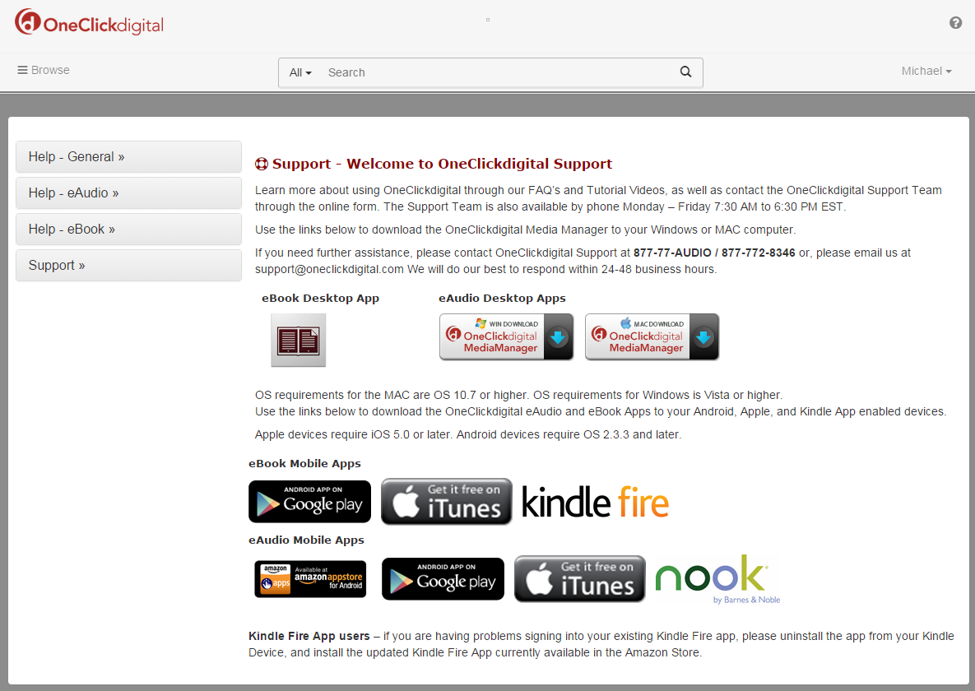
On your mobile device, open a web browser and go to: tinyurl.com/oneclickdigital-help
Click on the appropriate button for your device underneath the “eAudio Mobile Apps” sub-heading. This will take your to your device’s app store where you can download the OneClickdigital app for your device.

Slide 21
More Information
For more information on library ebooks and audiobooks, please see our E-Book Help page:
www.mc-npl.org/ebook-help

